Slide 1

Mini Project - 03
Bank Churn Prediction

Slide 2
Bank Churn Prediction
Business Oriented

Slide 3
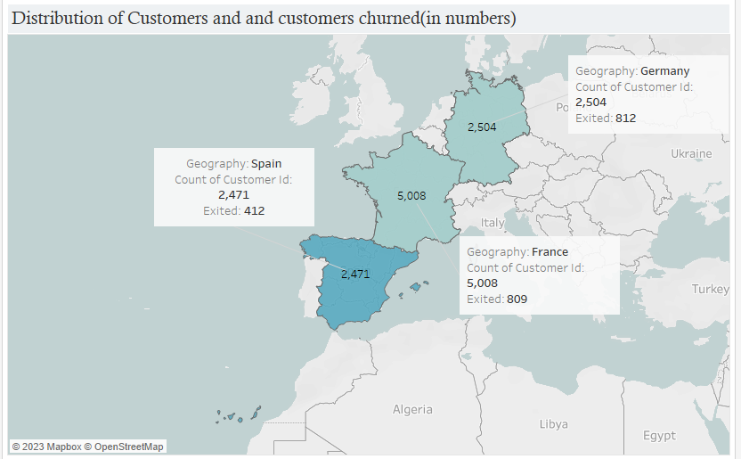
Bank Churn Prediction
Customers from Germany are leaving more.

Slide 4
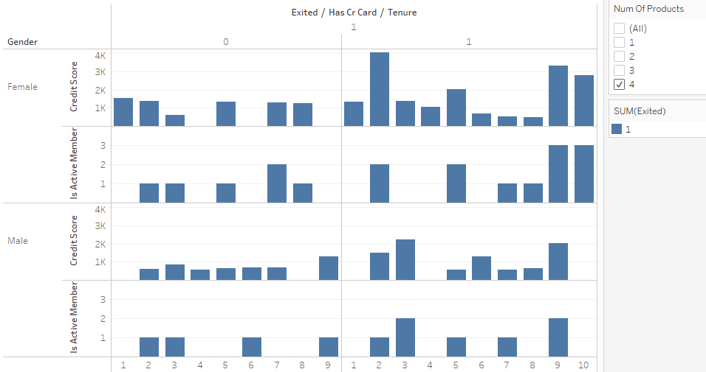
Bank Churn Prediction
All Customers With 4 products purchased from the bank are leaving.

Slide 5
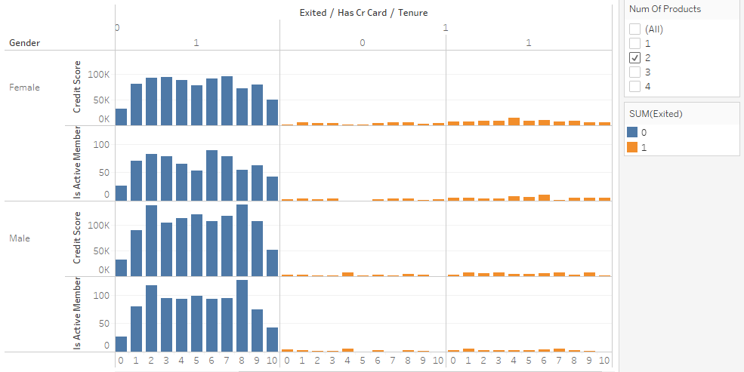
Bank Churn Prediction
The count of customers leaving the bank is less when customers are purchasing 2 products from the bank. W.r.t both male and female
Female customer is seen to leave more in comparison to male.

Slide 6
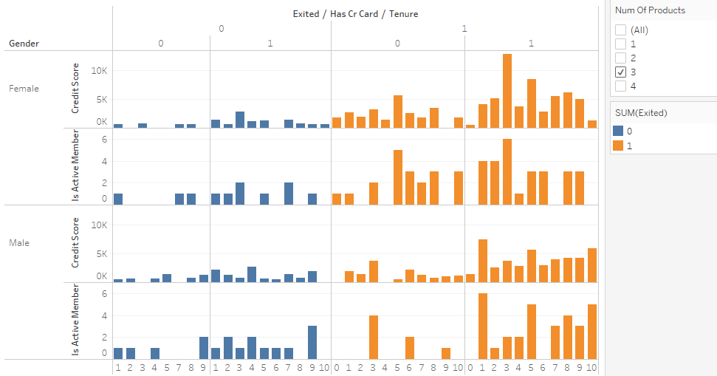
Bank Churn Prediction
Both male and female customers are leaving heavily when they had 3 products purchased.

Slide 7
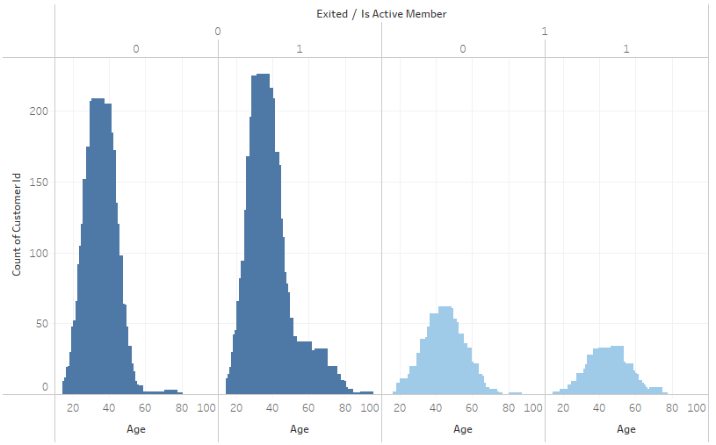
Bank Churn Prediction
Focus on Inactive customers who are exiting .
At most develop interest for all age groups or at least for age group between 35 to 55

Slide 8
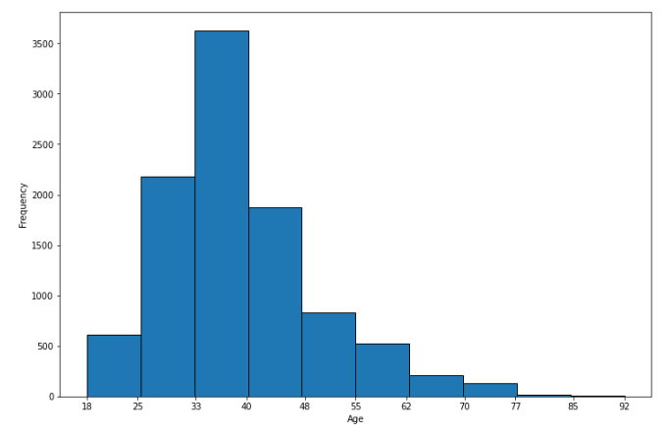
Bank Churn Prediction
Less young customers.
Company should target youth customers too.

Slide 9
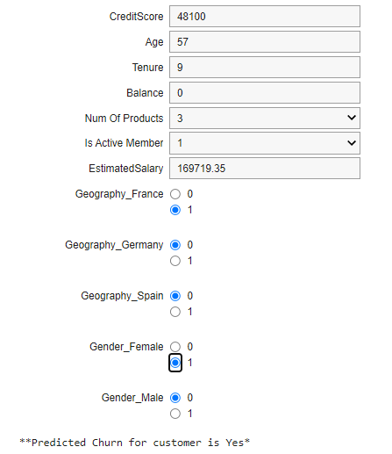
Bank Churn Prediction
Predict Customer churn using user interaction widgets for the labelled features.

Slide 10
Suggestion
- FOCUS ON Female customers FROM Germany and Spain.
- By giving Some offers to both active and inactive customers who are leaving at most.
- Or at least Provide offers for Active Customers whose age group is in between 35 to 55.
- Take a review of Products that are sold to a customer and improve if there is any problem with that, fix it because we have noticed as customers take more products, the Chance of leaving the bank is more.

Slide 11
Bank Churn Prediction
Technical Oriented

Slide 12
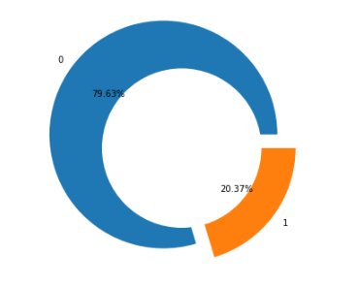
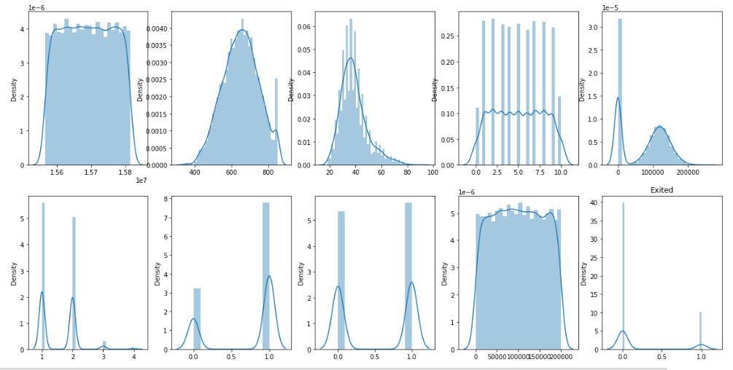
Bank Churn Prediction
Data is highly imbalanced
Data is Normally Distributed.
No null and special characters found.
Disturbance in Geography name was found Corrected the Names of geography locations.
Performed All possible EDA
Algorithms used to predict Bank churn data are as follows.
Logistic Regression > Because As it is Statistically based basic model.
Random Forest Classifier > Because there was Over fitting in Linear Regression.
Stacking Classifier > To improve its performance than Random Forest Classifier.
Multi Layer Stacking Classifier > To improve its performance than Stacking Classifier.

Slide 13
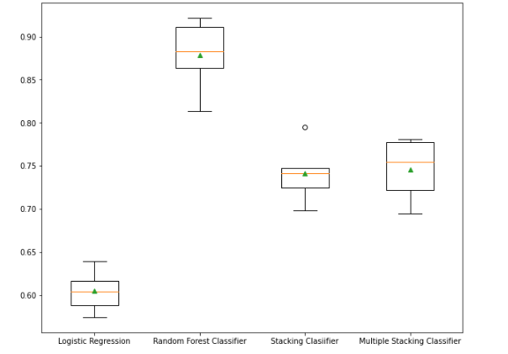
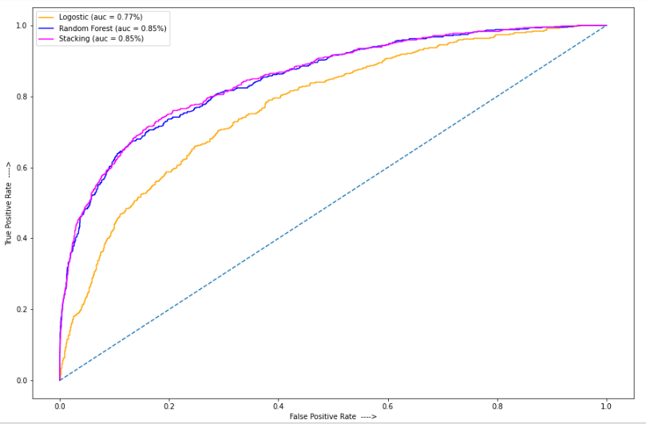
Bank Churn Prediction

Slide 14
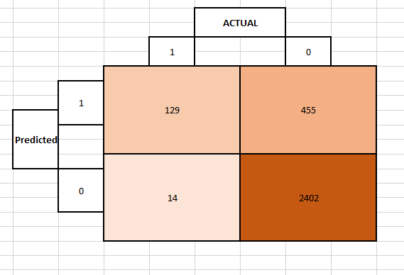
Bank Churn Prediction
Interpretation
Data is highly imbalanced so we cannot be dependent on metric 'accuracy'.
According to Business Scenario Precision is vital, Model should not predict a False Negative, if it does projects will get delayed.
Random Forest Classifier is giving the best Precision Score than any other models used above.
Also Random Forest Classifier has a good Area Under the Curve.
Best Parameters for Random Forest Classifier is {'criterion': 'gini', 'max_depth': 4, 'n_estimators': 20}
Click here to see the probability of customer churn.
Click here to see Workbook

Slide 15







THANK YOU

